Slide 1
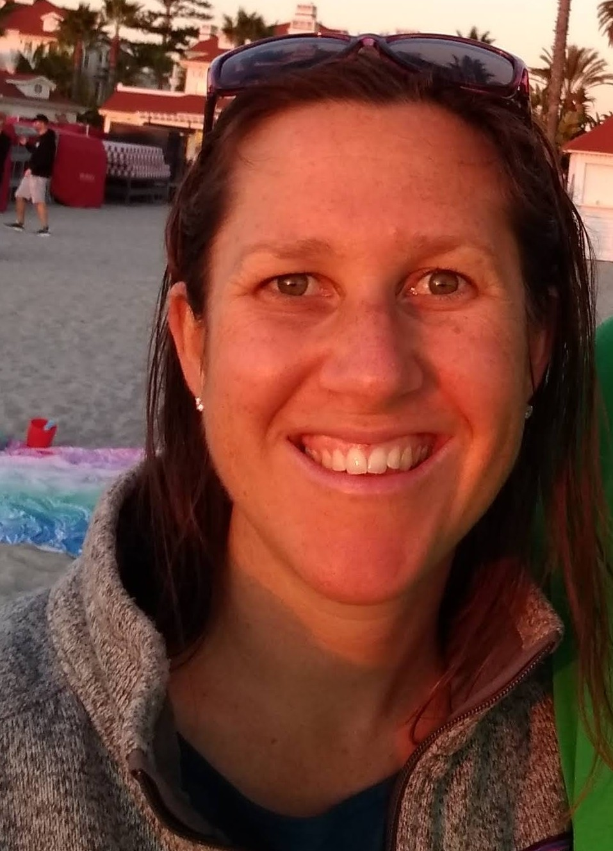
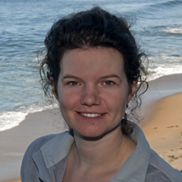


MarineDNA: Interpreting metabarcoding data through Bayesian models MBARI Project Update May 11 2023
Nastassia Patin
SIO / NOAA / SCCWRP
Kathleen Pitz
MBARI
Team members not present
Eric Archer
NOAA / NMFS
Kimani Kimbrough
NOAA / NOS

Slide 2
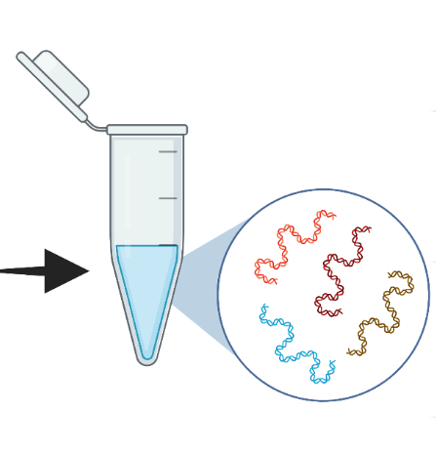
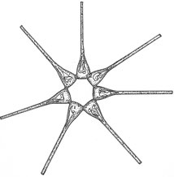
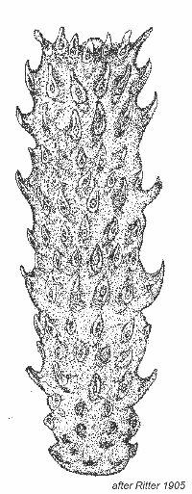
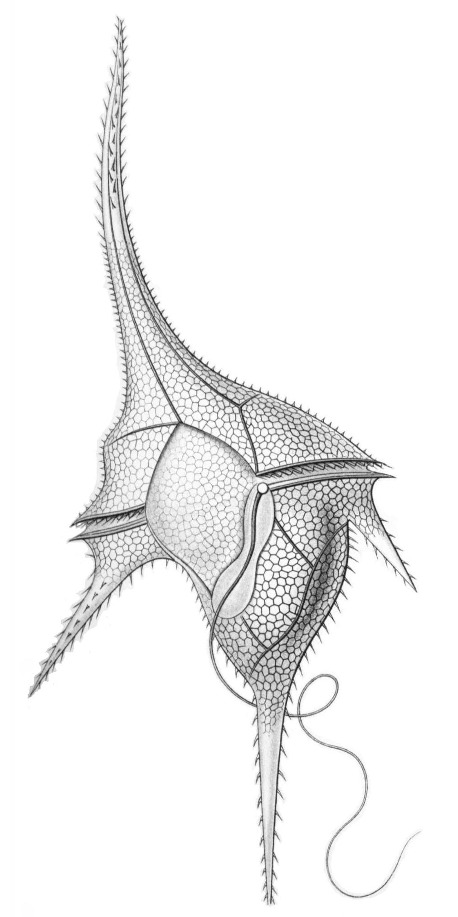
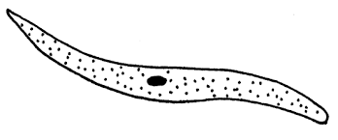
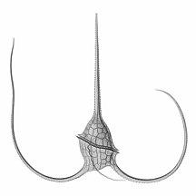

Metabarcoding data challenges
read counts are commonly represented as relative abundances
Sample 1
Taxon | Sample 1 | Sample 2 | Sample 3 | Sample 4
1 | 0.25 | 0.25 | 0.01 | 0.2
2 | 0.05 | 0.05 | 0.1 | 0.2
3 | 0.12 | 0.12 | 0.5 | 0.01
4 | 0.3 | 0.3 | 0.01 | 0.3
5 | 0 | 0 | 0 | 0.0001
Taxon
1
Taxon
2
Taxon
3
Taxon
4
Taxon
5
Taxon
6
Biases exist at every step of the process
Data sets typically have many more features than samples
These data are sparse (many 0s) and compositional (all values are relative to all other values)
No single marker gene captures all organisms
different genes are used for different levels of the food web

Slide 3
MarineDNA: Research questions
Can we model uncertainty around taxon relative abundances?
If data from a sequencing run is just one sampling from a complex environment, read counts may not be an accurate representation of abundance
Can we determine biological and/or environmental parameters that shape community structure?
Can we identify ASVs that link metabarcoding data from one trophic level to similar data from a different trophic level?
e.g., 16S bacterial ASVs that are drivers of 18S eukaryotic community structure

Slide 4
MarineDNA: Computational approaches
Modeling uncertainty
Generate beta distributions of read counts to provide range of potential data sets, each of which can be run through a model
Identifying drivers of community structure
PCAs and hierarchical clustering that use multiple random draws from the beta distributions
Linking metabarcoding data from different trophic levels
e.g., identifying 16S bacterial ASVs that are drivers of 18S eukaryotic community structure

Slide 5

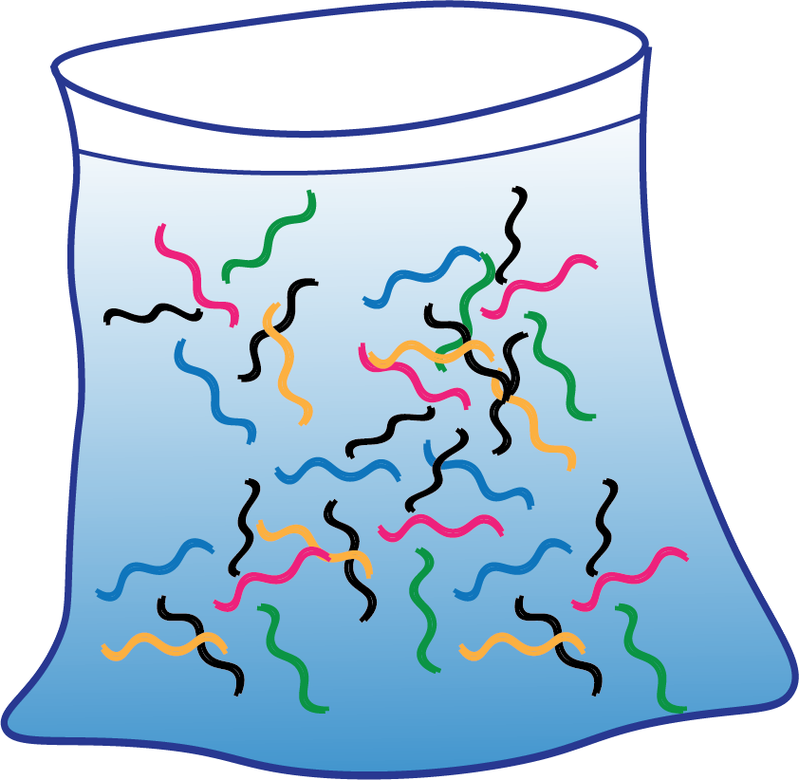
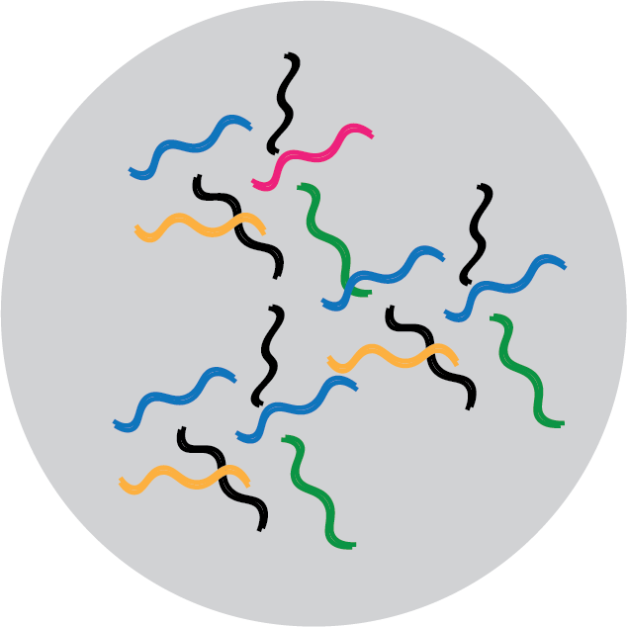




A water sample is just one draw from a natural distribution of DNA molecules
PCR
Sequencing
filter
proportion of sequences changes with biases in each step.
water sample
Sequence data is just one possible outcome of a PCR and sequencing reaction
We model this variability using a beta distribution:
The shape of the beta distribution, and the variability we model for each ASV depends on its relative abundance in a sample.
a = number of reads of an ASV within a sample
b = total number of reads in a sample
beta_dist = np.random.beta(a + 1, b - a + 1)
draw value
This value gets larger as an ASV has more reads
This value gets smaller as an ASV becomes a larger proportion of the total reads of a sample

Slide 6
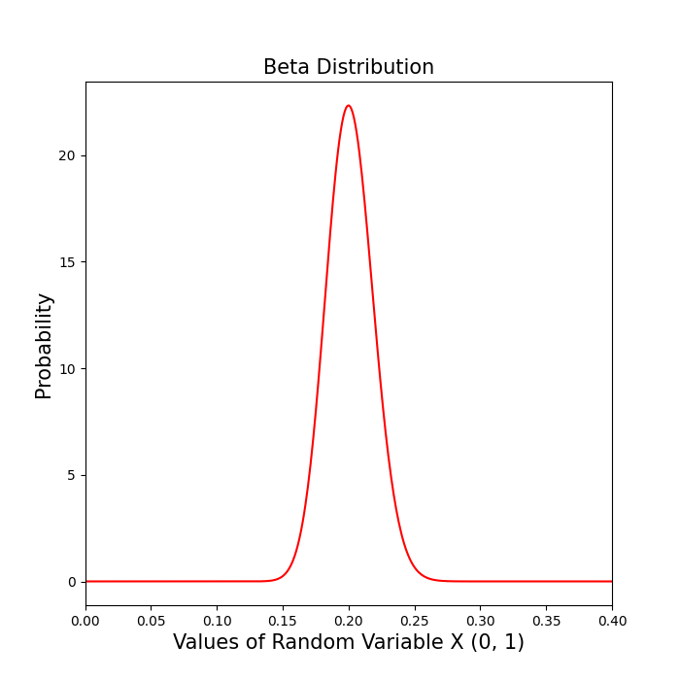
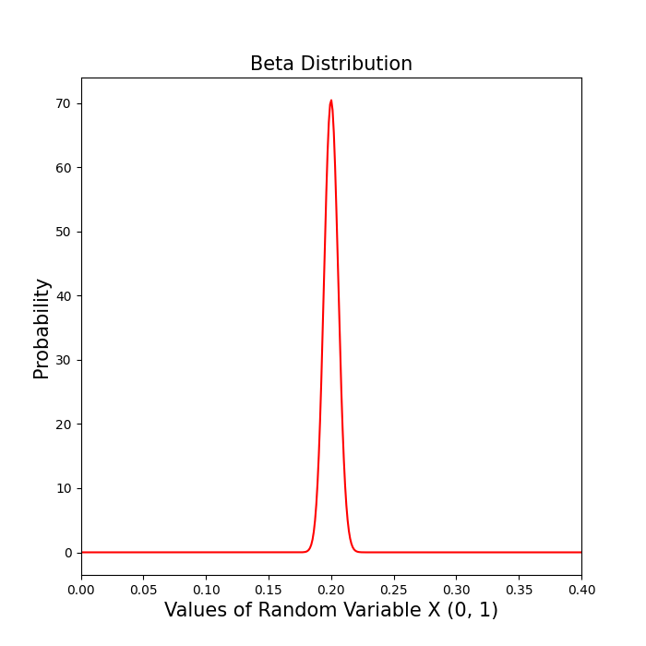
As the total number of reads in a sample increases, and as the proportion of an ASV within that sample increases, the narrower the beta distribution and the less variability across draws
For an ASV that is 20% of the total reads of a sample:
e.g. 1,000 reads out of 5,000 total
e.g. 10,000 reads out of 50,000 total
Low total reads
Low ASV reads
High variability
High total reads
High ASV reads
Low variability
Density
Density
As we draw for each ASV within each sample, ASV with lower read counts will be more variable across draws than ASVs with higher read counts.

Slide 7
Now our ASV table’s raw reads are instead values drawn from a beta distribution ranging from 0 to 1, but are no longer compositional (do not need to add up to 1.0)
This linear scale lets us then conduct different statistical analyses such as:
PCA
Hierarchical Clustering
And we can examine these outputs (from many draws of the data) using Bayesian modeling techniques.

Slide 8
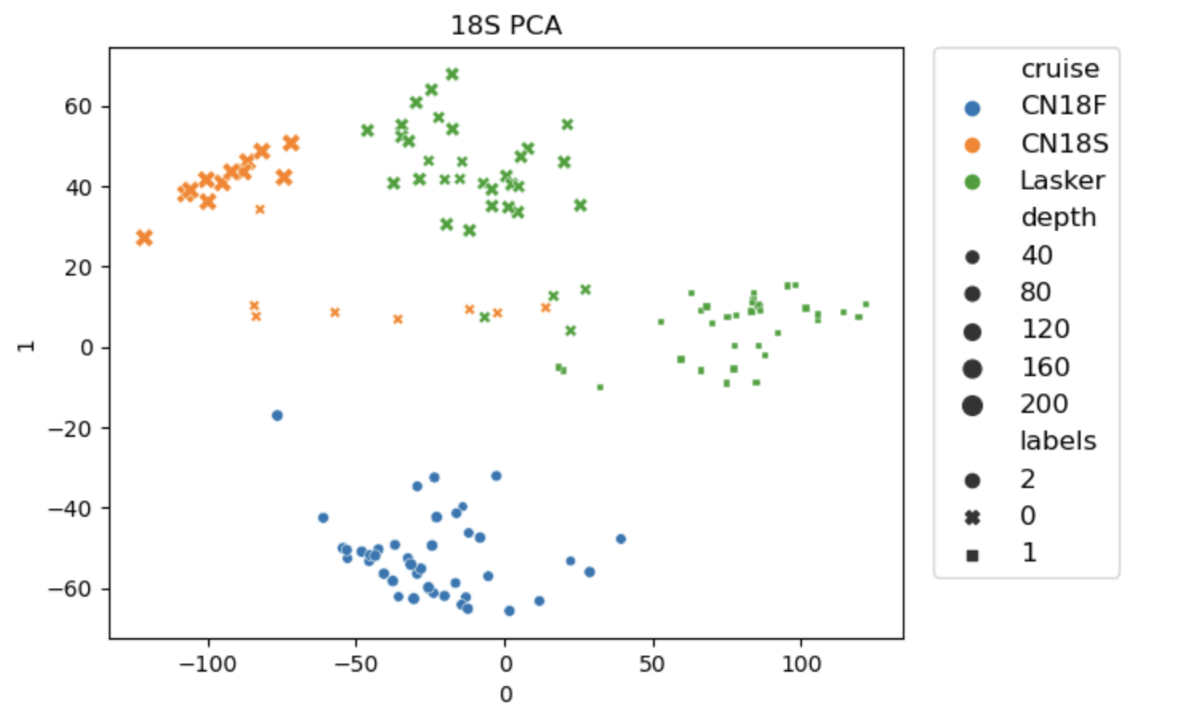
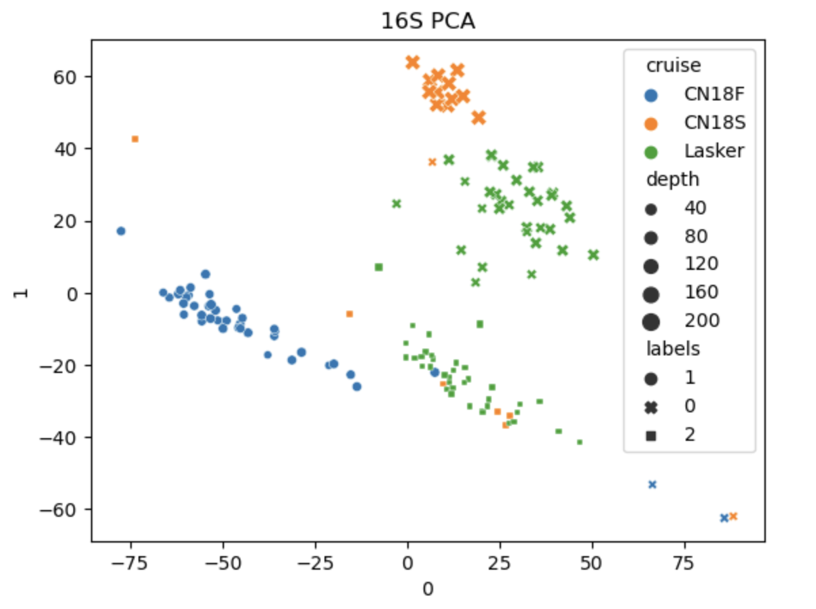
MarineDNA Concepts: PCAs
What is the variability in our data set?
Principal component analysis (PCA)
A principal component (PC) is a measure of variability in one dimension of PCA space
Loading scores represent how much each ASV affects each PC
We can generate 1000s of PCAs to leverage information from the probability distributions
Loading scores from all replicates can be calculated and summarized (e.g., mean and median values)
If we only knew 16S community composition, how well can we predict variability in 18S community composition?

Slide 9
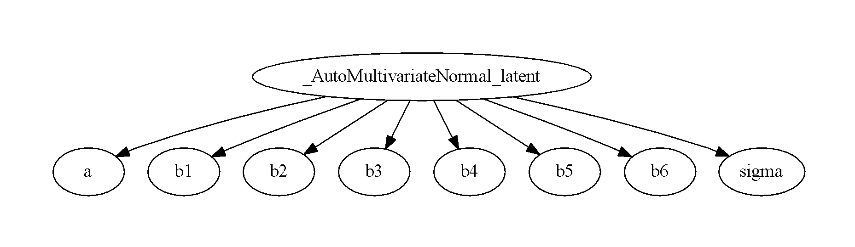
MarineDNA Concepts: Bayesian modeling
y = a + b₁x₁ + … + b_{i}x_{i} + sigma
18S PC1
16S PC1
Bayesian modeling provides framework to answer question of predictive power by using data distributions
We can generate a regression to look at relationship between PCs
Instead of tests for significance, we generate a distribution of possible outcomes
There are different “flavors” of Bayesian modeling in Python, including ML-based
MCMC, SVI, NumPyro
What are the most influential ASVs for 16S PC1?
Look at ASVs with highest loading scores
Notes:
One component of variability affecting another component of variability

Slide 10
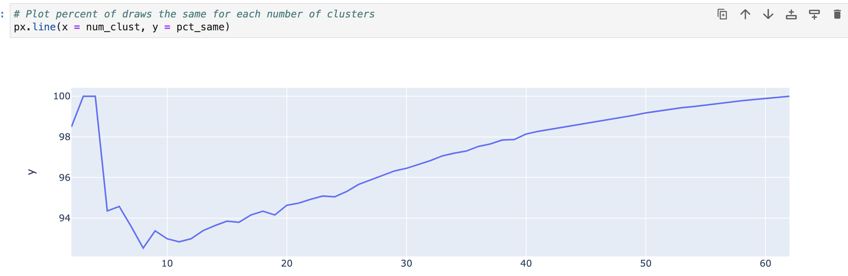
MarineDNA Concepts: clustering
Generate different numbers of clusters ranging from 2 to n, where n is the total number of samples
Run cluster analyses some number of replicate times
From all the replicates, calculate what percentage of sample pairs occur in the same cluster
The number of clusters with the highest percentage is the optimal cluster number
3 or 4 clusters are equally optimal in this example
100% of sample pairs are clustered together in all replicate analyses
Notes:
Clustering done with scikit-learn ‘AgglomerativeClustering’ function; Euclidean distance, ward linkage
“itertools” library used to generate all pairwise sample combinations

Slide 11
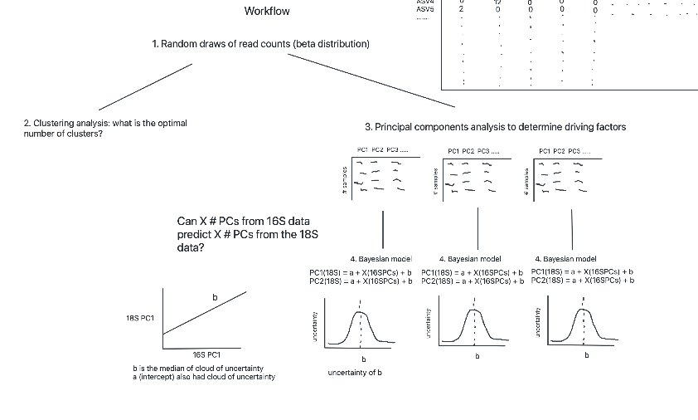
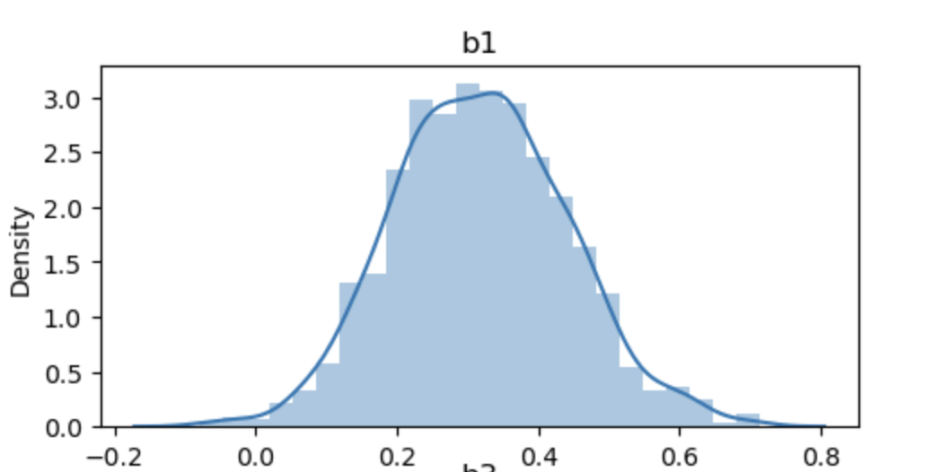
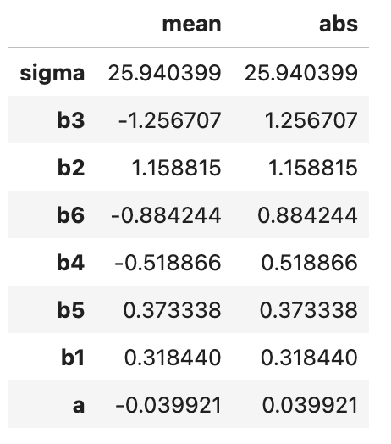
MarineDNA: Putting it all together
Samples
Samples
1. Random draws of read counts (beta distribution)
0.1
0.25
0.05
ASVs
0.2
0.01
0.1
ASVs
0.05
0.3
0.02
2. Clustering analysis
3. Principal components analysis
Can X PC from 16S data predict X PC from 18S data?
4. Bayesian model
PC1(18S) = a + X(16SPCs) + b
PC2(18S) = a + X(16SPCs) + b
4. Bayesian model
PC1(18S) = a + X(16SPCs) + b
PC2(18S) = a + X(16SPCs) + b
4. Bayesian model
PC1(18S) = a + X(16SPCs) + b
PC2(18S) = a + X(16SPCs) + b
4. Bayesian model
PC1(18S) = a + X(16SPCs) + b
PC2(18S) = a + X(16SPCs) + b
This table represents first 6 PCs and their slopes (16S vs 18S)
uncertainty of b
Notes:
PC1 is not necessarily the best predicted!

Slide 12
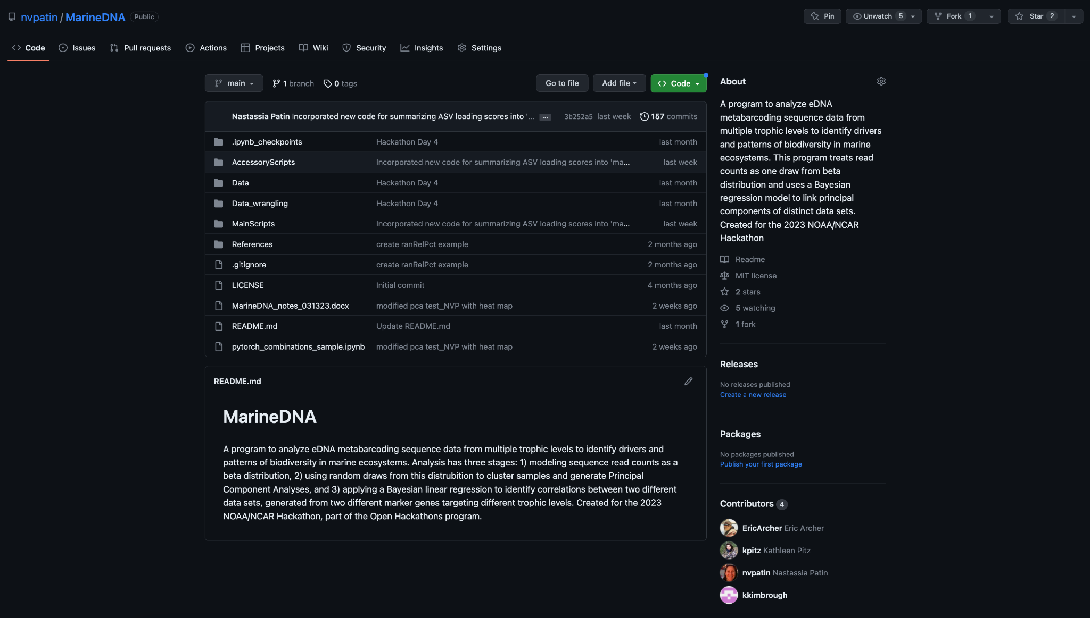
https://github.com/nvpatin/MarineDNA

Slide 13

NOAA/NCAR OpenHackathon Experience
Sponsored by NVIDIA, a computing hardware company
HPC, GPUs, computing platforms optimized for ML/AI
Run by NOAA and NCAR, the National Center for Atmospheric Research in Boulder, CO
NVIDIA’s goal: demonstrate how GPUs can accelerate computation
Our goal: create a robust and efficient program to analyze marine metabarcoding data
Access to a computing cluster was provided for the hackathon

Slide 14


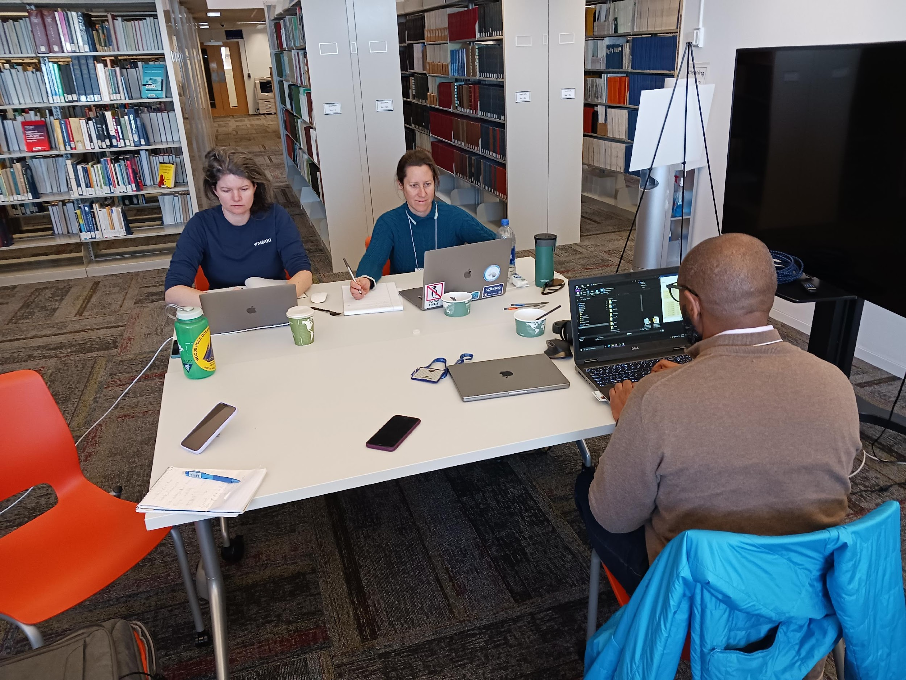
NOAA/NCAR OpenHackathon Experience

Slide 15
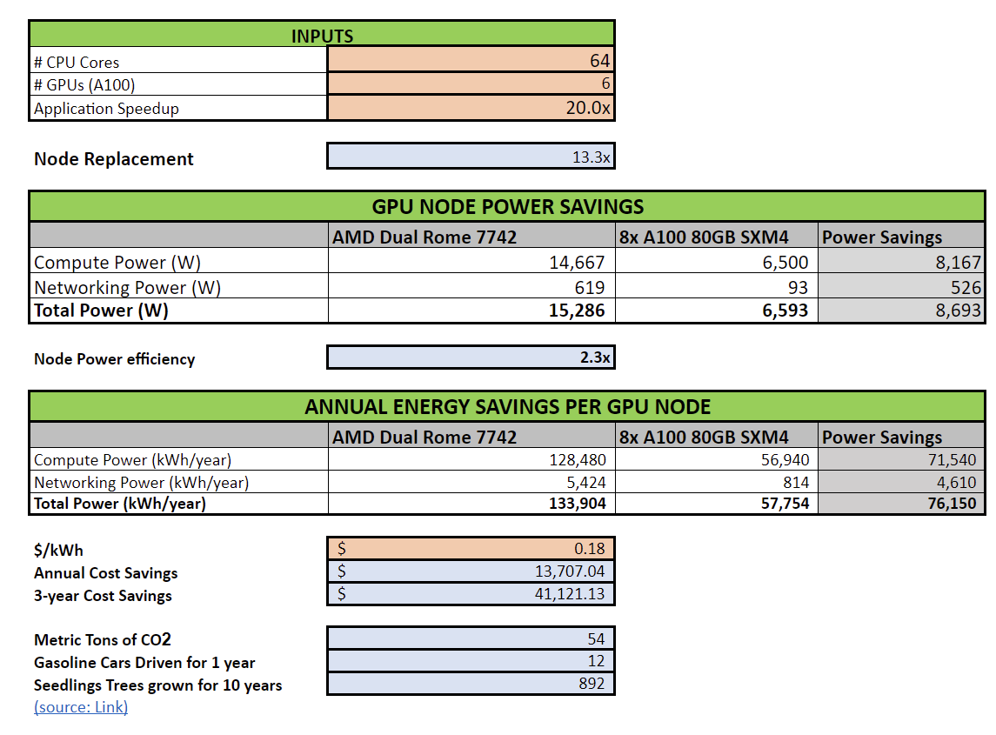
Energy Efficiency
The calculator will compare energy consumption of a number of CPU only nodes with dual CPUs required to perform the same amount of work as 1 GPU node with 2 CPUs and 8 GPUs.
Use this calculator for your report
Add your acceleration numbers in the INPUTS section
Modify $/kwh number if necessary
Paste a screenshot similar to the one on the right in this slide to report energy efficiency of your project

Slide 16
NOAA/NCAR OpenHackathon Experience
Valuable opportunity to work intensively with scientists from other disciplines with different skill sets
Gained a suite of new knowledge
statistical concepts (Bayesian and ML)
programming skills
how to deploy these skills on more powerful computing platforms
Challenges included bridging vocabulary gaps
among scientists from different fields
between scientists and computational administrators
We are continuing this work independent of the hackathon and will deploy the program on RDHPCS/Google Cloud using GPUs

